Slide 1

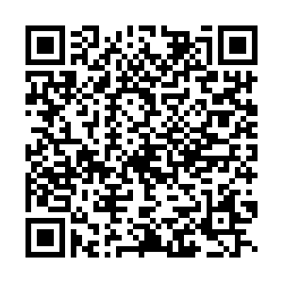
Google Interest Form
Fill out our interest form to receive info about upcoming events, career prep sessions, job/internship applications, scholarships, and more
A few examples of the opportunities/events you’ll receive info about:
Resume workshops, interview prep sessions, and other professional development events led by Googlers
Job/internship posting updates and application resources
Scholarships/conference opportunities
Sign up:
Via QR below
Notes:
Google is looking to connect with CS students at UIC! Please complete the form via QR above to receive updates on upcoming events, applications, scholarships, conferences, and more!

